Slide 1





A6AI
THE FUTURE OF SHOPPING
Shop with Voice, Style with AI

Slide 2








Submitted By
Md Moinul Islam Sajid
Md Shakib Hossain
Ahasun Mia
Mahamudul Hasan
Abdullah Al Noman
Md Riaz Hossain

Slide 3


Submitted To
Md Nahid Hasan
Lecturer, Dept. of CSE
Dhaka International University

Slide 4
Agenda
Introduction & Problem
3 Core AI Features
System Design
Live Demo
Tech & Challenges
Thank You

Slide 5






Current E-commerce in Bangladesh
No Multi-Mode Search
No AI Chatbot

Slide 6
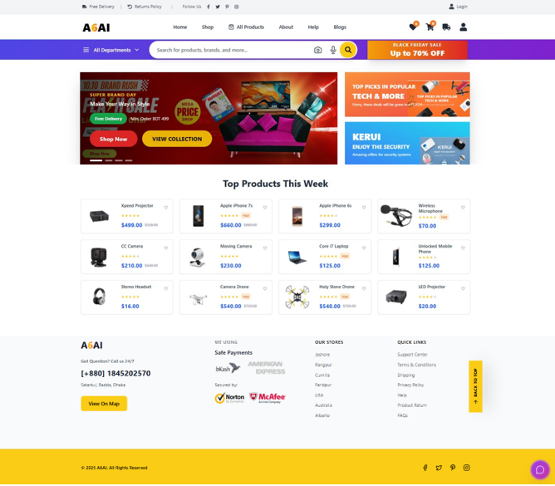
A6AI – Homepage Overview
Modern, Fast, AI-Powered

Slide 7




Our 3 Game-Changing AI Features
01
02
03
ShopVerse AI Chatbot.
(Voice + Text)
Triple-Mode Search
(Text / Voice / Search)
Personalized Recommendations
(based on user past orders)

Slide 8
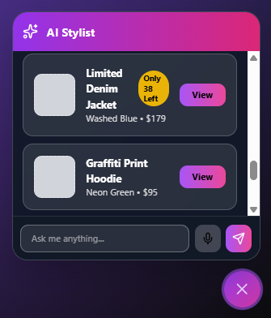

1. ShopVerse – Always With You
Initial Icon
Never disappears Voice + text input
Understands English Language

Slide 9



2. Triple-Mode Search
Search with Text
Search with Voice
Search with Image
All work offline No extra app needed

Slide 10
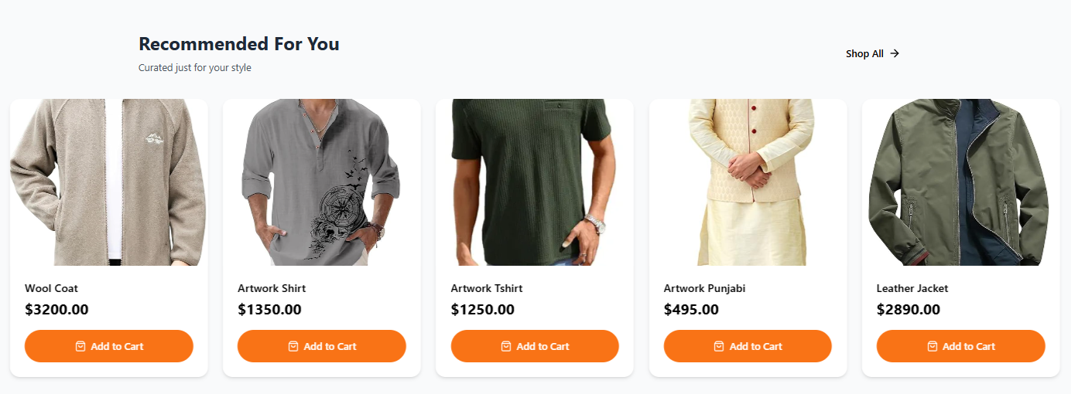
3. Smart Recommendations
Uses user past orders (Era’s Wool Coat, Leather Jacket, etc.)

Slide 11
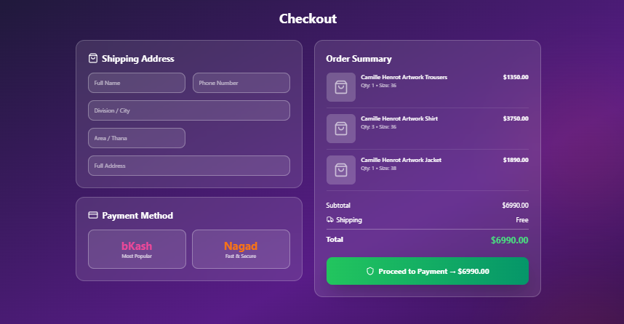
Beautiful Checkout Experience
Glassmorphism + bKash/Nagad

Slide 12
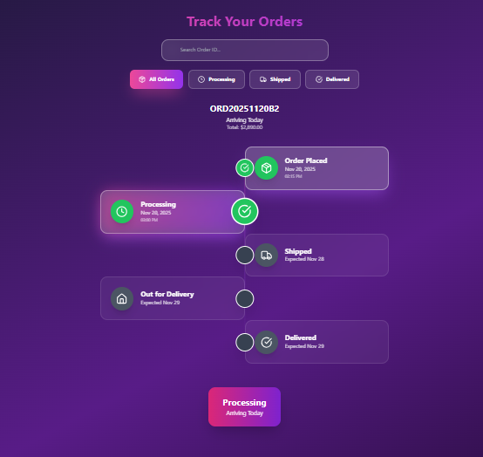
Animated Order Tracking
Glowing timeline animation

Slide 13
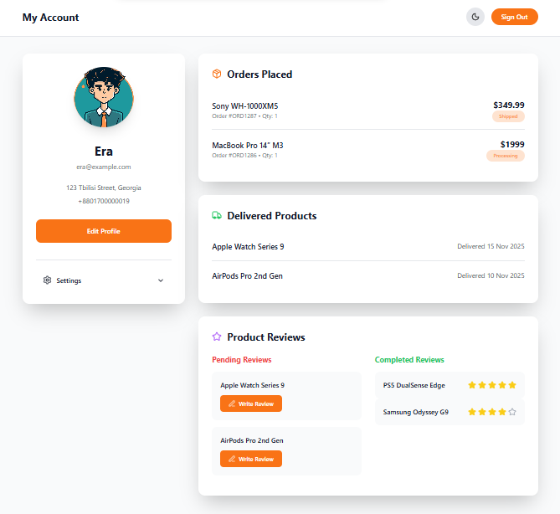
My Account Dashboard
Orders, Delivered items, and Reviews

Slide 14
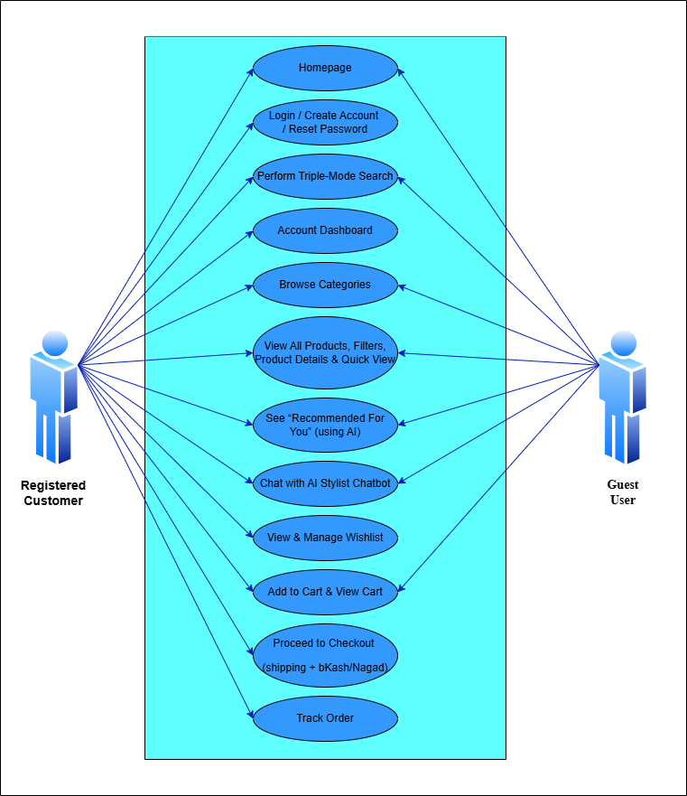
Use Case Diagram
Guest and Registered User

Slide 15
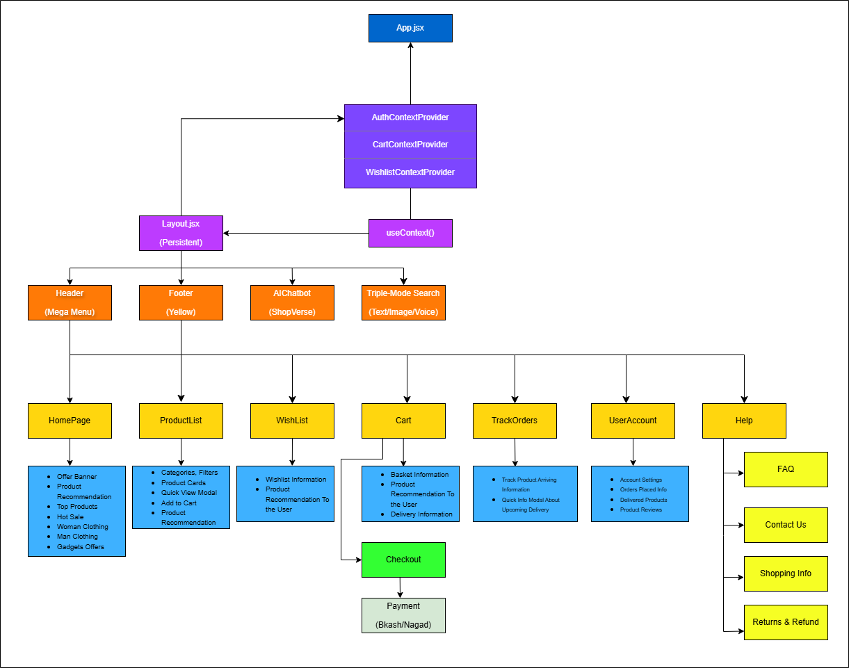
Component Architecture

Slide 16
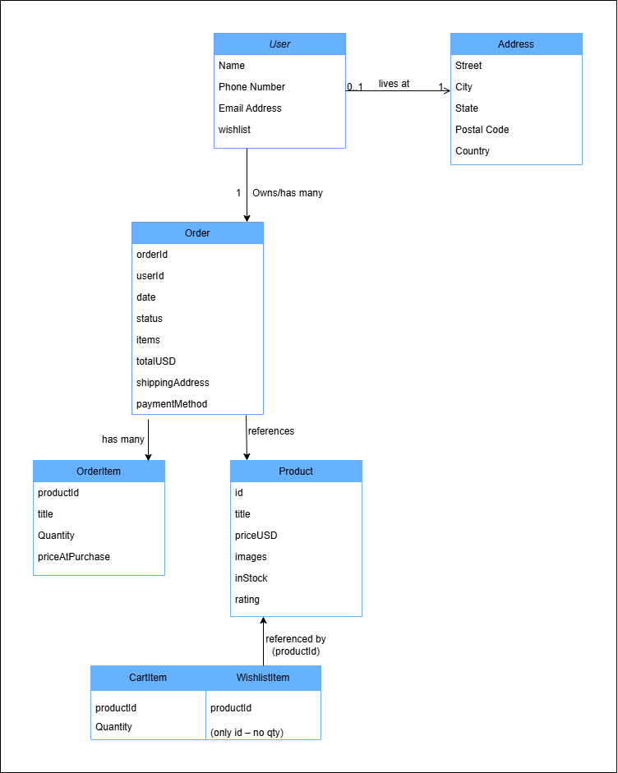
Client-Side Data Model
User, Product, Cart, Wishlist,
Orders

Slide 17
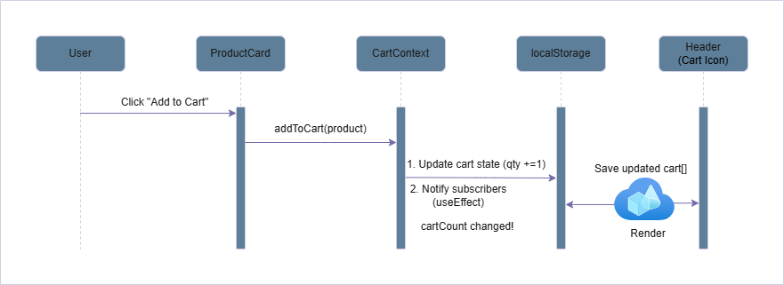
Sequence Diagram - Add to Cart

Slide 18
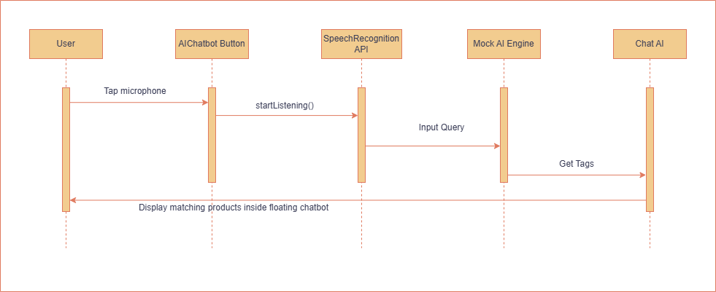
Sequence Diagram – ShopVerse AI Flow

Slide 19
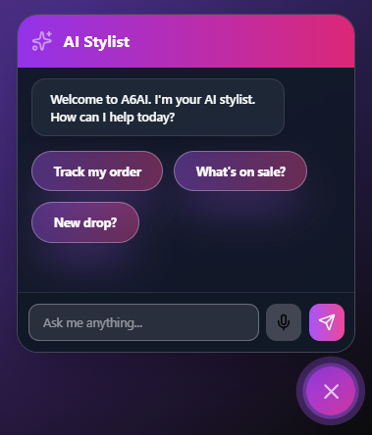
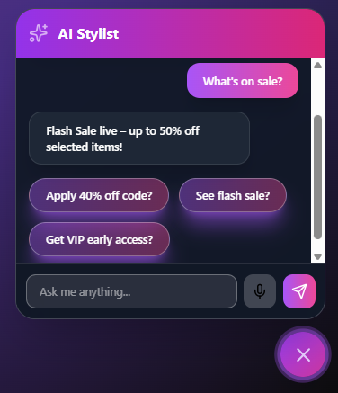
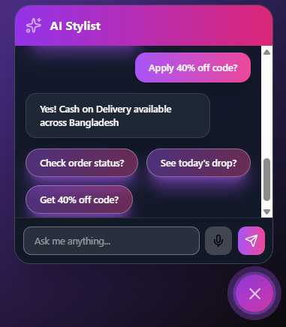

ShopVerse in Action
01
02
03
Exactly 3 relevant question will suggest in every reply

Slide 20
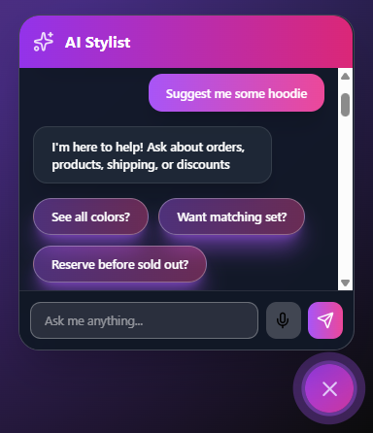
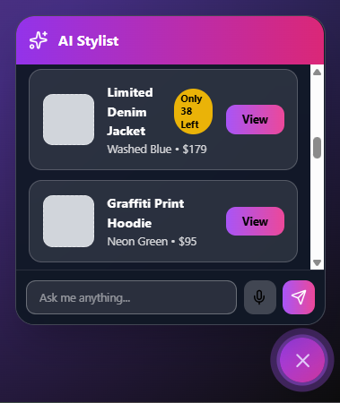
ShopVerse in Action
ShopVerse can suggest multiple product in chat

Slide 21
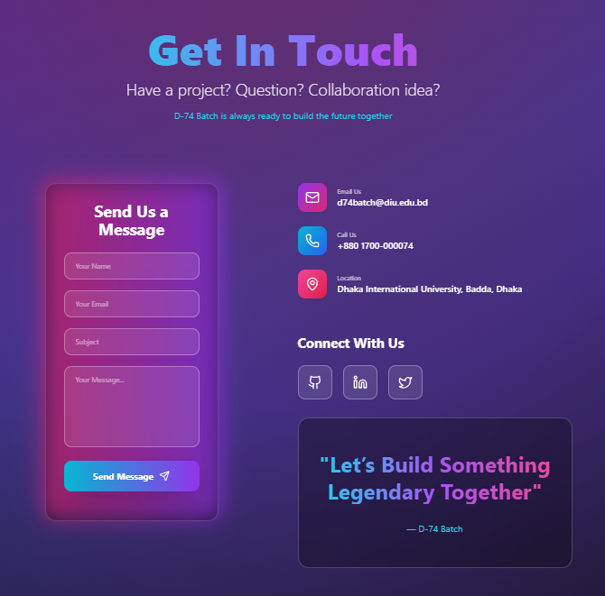
Contact Us
User can Contact us through many way for Support

Slide 22
Technology Stack
Local Storage
Framer Motion
Tailwind
Vite
React 18
Only Frontend

Slide 23
Challenges We Solved
1. Modern search in single site
2. True personalization using order
history
3. Smart chatbot that recommends
real products

Slide 24



Results
01
02
03
3 Real AI Features
100% Offline
User Friendly UI

Slide 25






Future Scope
01
02
03
04
Real Backend
Search By Image
Bangla Voice
Augmented Reality

Slide 26


Slide 27
A6AI
THANK YOU
Questions ?

